Slide 1
Auto-Calibration of HELIOS Data
2018-July-16th , Ryan Tang

Slide 2
The Problem
Difference detector has difference gain, or MeV-to-channel
Manual or Semi-Manual method
Flatten e’ = a*z - e
Automatic method
Compare e(exp) with e(simulation)
(least square method)
Manually to find a
Set correlation = 0
align e’ for difference detectors

Slide 3
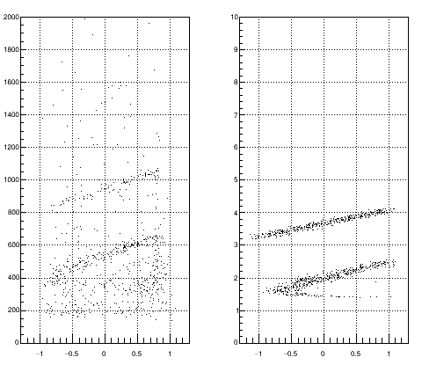
Idea
Exp
Sim
Since the e-z plot is completely determined by kinematics
We can “map” the experimental plot to simulated plot
Challenge -- noise
~260 times smaller
Noise

Slide 4
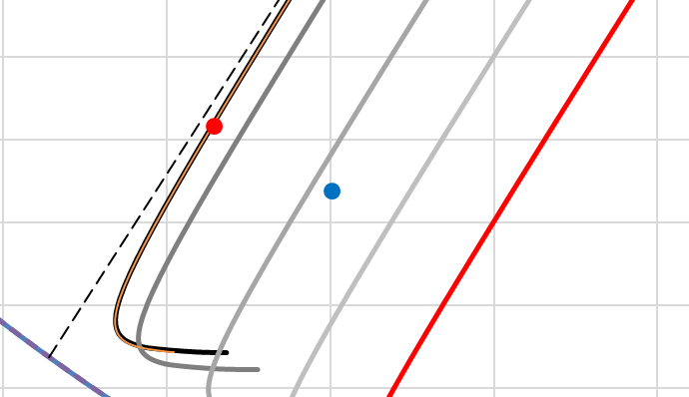










Algorithm – least square method
User define parameters:
$D_{threshold}$ = 0.02
$e_{threshold}$
Search range for (a,b)
Monte Carlo trial
Pick a point in experimental data,
Scale the energy,
Find the point in simulation data,
So that is minimum.
Obtain = Sum of all D.
Find the (a,b), so that is minimum.
Monte Carlo Search
$$\vec{r_{i}}=(z_{i},e_{i})$$
$$\vec{R_{i}}=\left(z_{i},e_{i}^{′}\right), e_{i}^{′}=\frac{e_{i}}{a}+b$$
$$\vec{A_{ij}}=\left(z_{i}, f_{j}\left(z_{i}\right)\right),$$
$$D_{i}={\left|\vec{R_{i}}−\vec{A_{ij}}\right|}^{2} ∃j$$
$$D_{i}>D_{threshold}→D_{i}=D_{threshold}$$
the threshold can discard the noise
$$∑D_{i}$$
$$D_{i}$$
$$f_{j}\left(z_{i}\right)$$
$$∑D_{i}$$

Slide 5
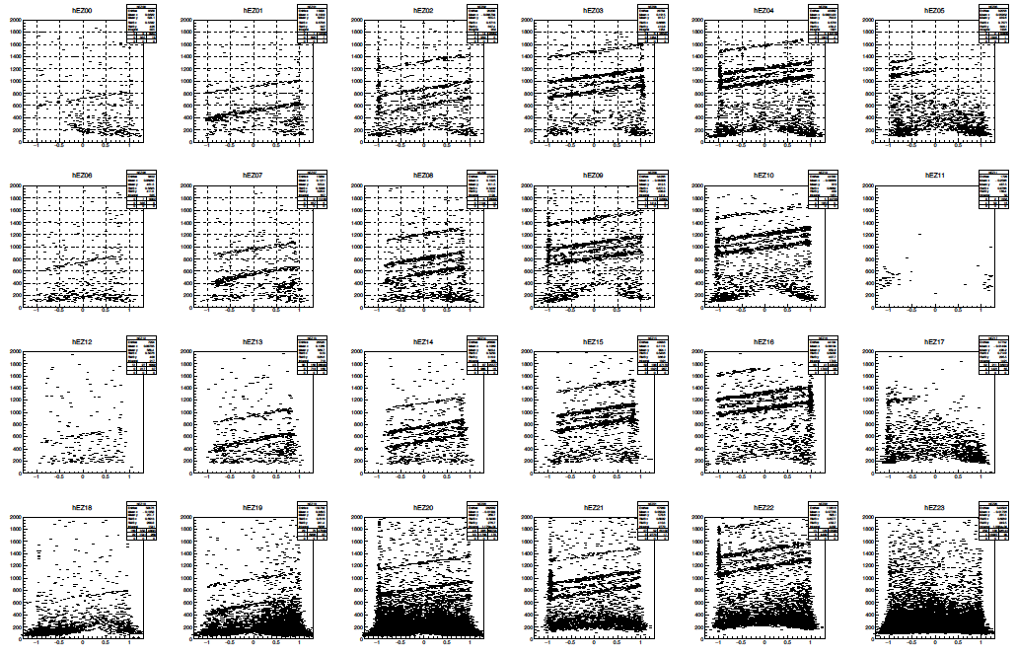
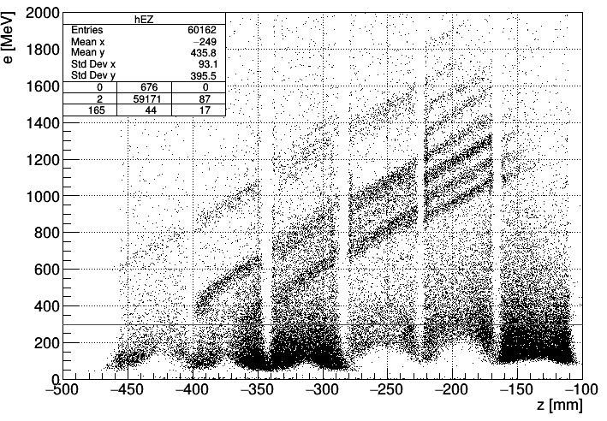
Origin data, not aligned
Experimental Data
eThreshold

Slide 6
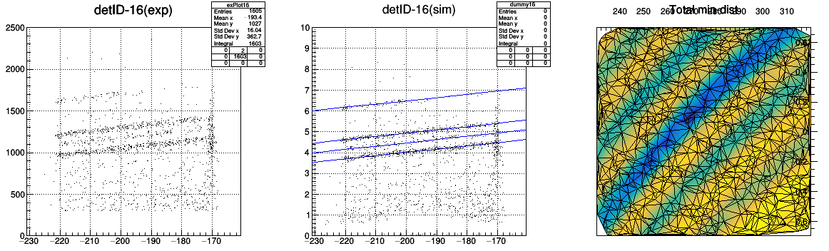
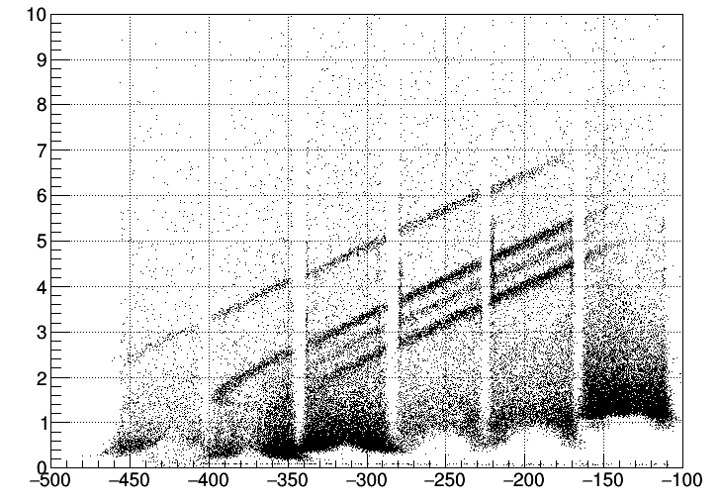
Result
1000 trials
e [a.u.]
Origin data
e [MeV]
Accurate.
Well aligned.
Close to resolution of manual-Cali
Fast
6 mins

Slide 7
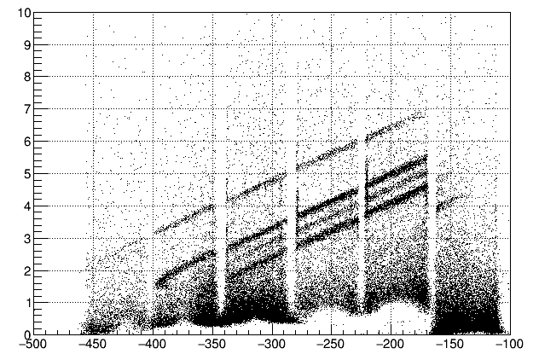
Result – (e-z plot)
The resolution is as good as Manual.
Manual Calibration ( ~ few days)
Auto Calibration ( ~ few mins)

Slide 8
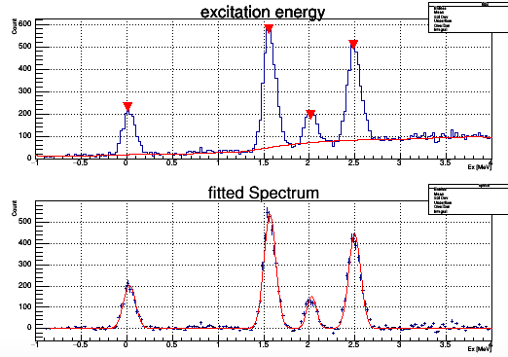
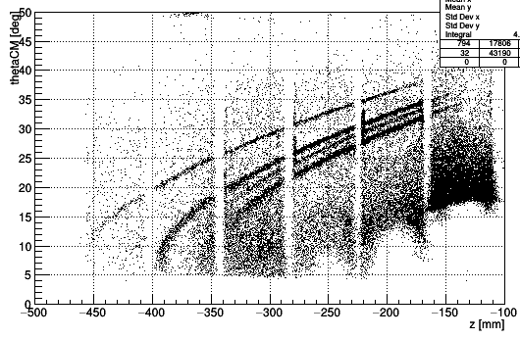
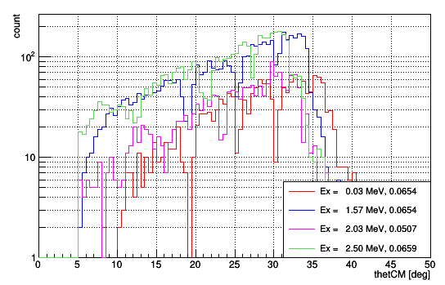
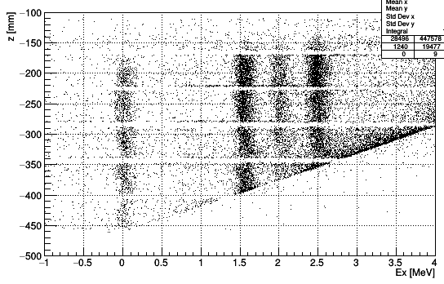

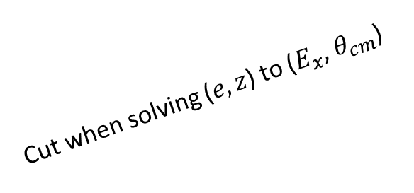
Sigma : 65 keV
Manual sigma : 60 keV
small thetaCM
$$\frac{dσ}{dΩ}$$
Ex ± 3 Sigma
Cut when solving ($e,z$) to ($E_{x}$, $θ_{cm}$)

Slide 9
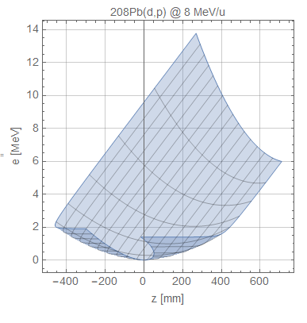
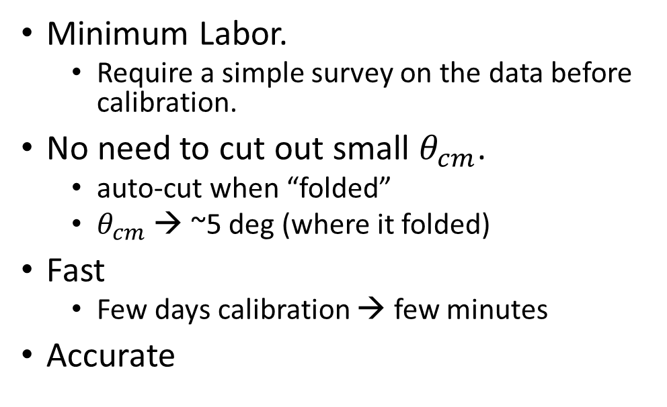
Advantage
Minimum Labor.
Require a simple survey on the data before calibration.
No need to cut out small $θ_{cm}$.
auto-cut when “folded”
$θ_{cm}$ → ~5 deg (where it folded)
Fast
Few days calibration → few minutes
Accurate
Folded

Slide 10
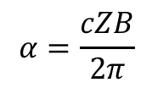


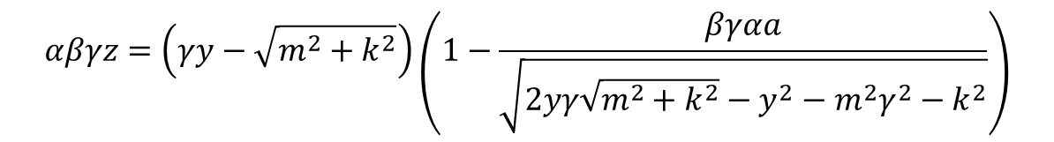




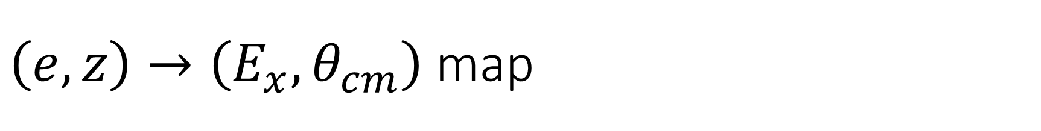











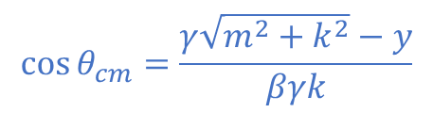
$\left(e,z\right)→\left(E_{x},θ_{cm}\right)$ map
$k$ = momentum of b or B in CM frame
$m$ = mass of proton
Solve for $k$
$β$ = beta for center of mass 4-vector
$$αβγz=\left(γy−\sqrt{m^{2}+k^{2}}\right)\left(1−\frac{βγαa}{\sqrt{2yγ\sqrt{m^{2}+k^{2}}−y^{2}−m^{2}γ^{2}−k^{2}}}\right)$$
$$y=e+m$$
$$α=\frac{cZB}{2π}$$
The equation can be reduced to the form
$a$ = radial distance of the axis to detector
$$Z=αβγz$$
$$Z=H\sin{φ}−G\tan{φ}$$
$$G=αβγa$$
Solve for $φ$
$$H=βγ\sqrt{y^{2}−m^{2}}$$
$$k^{2}={\left(γy−H\sin{φ}\right)}^{2}−m^{2}$$
$$E_{B}^{2}=m^{2}+E_{t}^{2}−2E_{t}\sqrt{m^{2}+k^{2}}$$
$E_{t}$ = total energy in CM frame
$$E_{x}=E_{B}−m_{B}$$
$E_{B}$ = total energy of recoil particle in Lab frame
$$\cos{θ_{cm}}=\frac{γ\sqrt{m^{2}+k^{2}}−y}{βγk}$$
$m_{B}$ = mass of recoil particle

Slide 11



Faster Searching Method – Random Walk
Search square
Size of search square reduced
Search square
Search square
$${f(k}_{i+1})<f\left(k_{i}\right)$$
No longer need.
But interesting to explore.
$${f(k}_{i})$$
$${f(k}_{i+1})>f\left(k_{i}\right)$$

